Slide 1

Build for the Web with FastAPI
Michigan Python

Slide 2

I Spy the Pokémon
My kids spend hours memorizing all 1000+ Pokémon
They enjoy playing a game at the dinner table, it goes something like:
“I Spy a Pokémon that is a Dark and Poison type”
“I don’t know any Dark and Poison type, I give up”
“Come on Dad, it was Overqwil, everyone knows that!

Slide 3
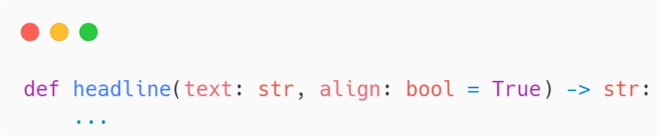
Typing
Python has a dynamic typing system
It does support type hints
Helps document your code
Supports IDEs and linters
With extra libraries, like Pydantic, can support runtime checks

Slide 4
The Libraries
I learned Python, it was a great weekend…
and then I spent a lifetime mastering the libraries
Libraries are the tools in your toolbox, we are going to use a few of them for this project

Slide 5
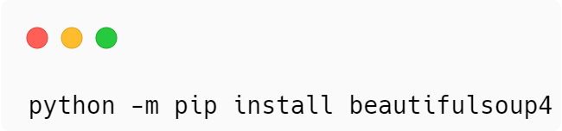

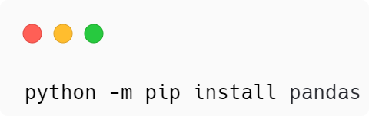
Step 1 – Get Some Data and Process It
Beautiful Soup pulls data out of HTML and XML files. It works with your favorite parser to provide idiomatic ways of navigating, searching, and modifying the parse tree.
Pandas allows for working with the data in a collection of columns called a dataframe

Slide 6


Step 2 – Store the Data in a Database
SQLite is a C library that provides a lightweight disk-based database that doesn’t require a separate server process, sqlite3 is the Python library in the standard library
DB Browser for SQLite – open source desktop app to create, design, and edit database files compatible with SQLite

Slide 7

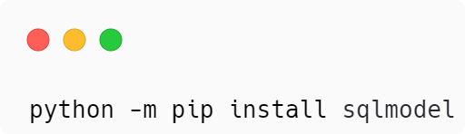
Step 3 – Develop Python Schema
SQLModel is a library for interacting with SQL databases from Python code, with Python objects.
Based on Python type annotations and powered by Pydantic and SQLAlchemy.

Slide 8
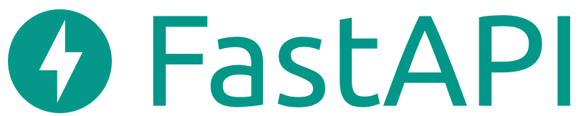
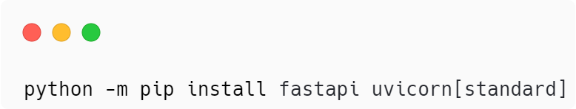
Step 4 – Develop APIs to Access the Data
FastAPI is a modern, fast (high-performance), web framework for building APIs based on standard Python type hints
Lightning Fast – On par with NodeJS and Go
Fast to Code
Fewer Bugs
Intuitive and Easy

Slide 9


Pydantic and Starlette
Provide the building blocks for FastAPI
Pydantic does runtime type checking
Starlette provides an Async Server Gateway Interface (ASGI) framework to build web services

Slide 10

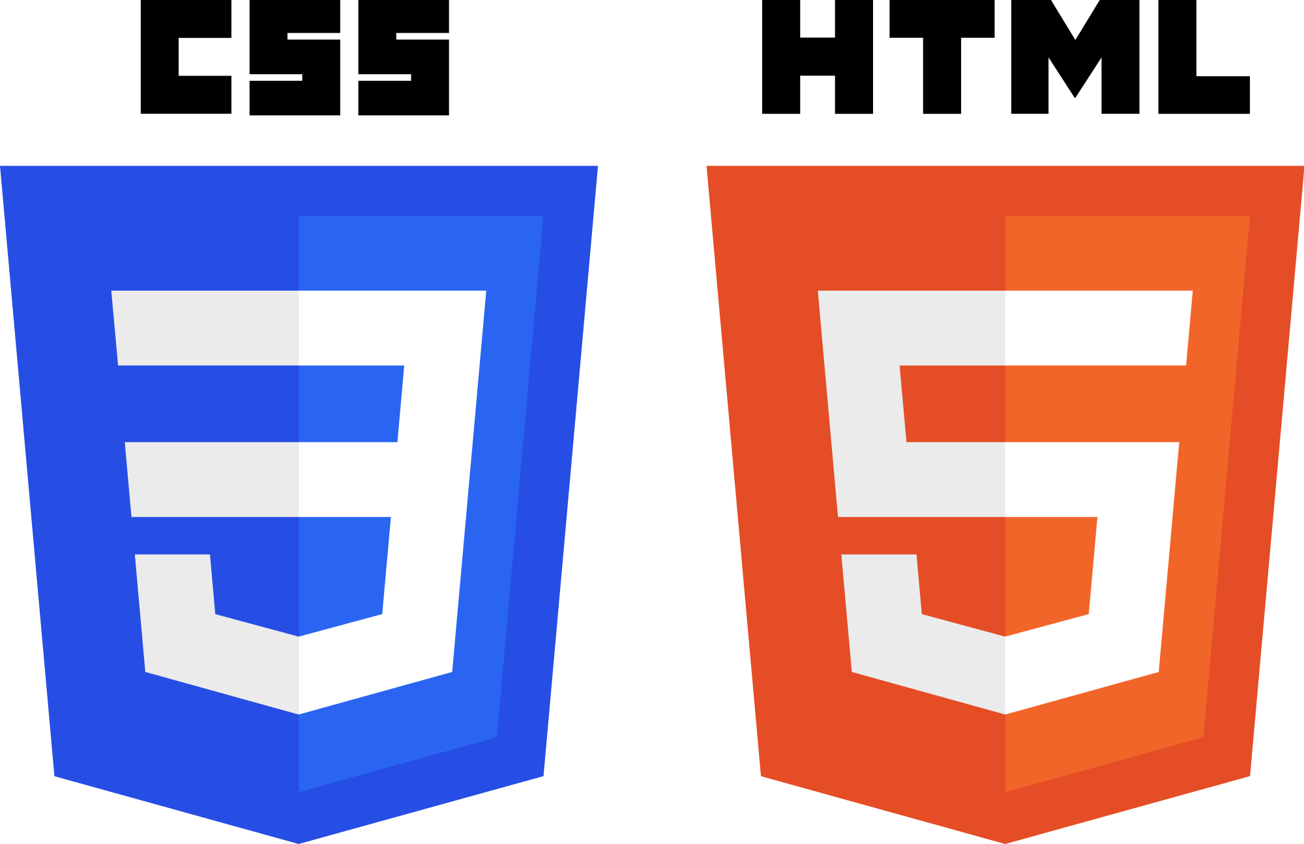
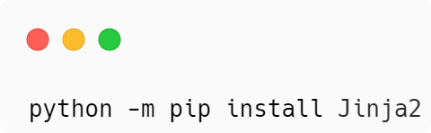
Step 5 – Build the Frontend
I kept things simple here: HTML and CSS
Jinja templates to inject returned data from the background

Slide 11

Step 6 – Deploy to the Web
Google Cloud Platform (GCP) will be used to deploy to the web, any other cloud hosting provider will work (AWS, Azure, DigitalOcean, Heroku, PythonAnywhere, Linode, etc)

Slide 12

Docker
Automates the deployment of applications inside software containers

